Slide 1
PL/ SQL
FUNCTIONS AND PROCEDURES
BY: 20PW17
20PW18
20PW19

Slide 2
PL/ SQL SUBPROGRAM
FUNCTIONS
PROCEDURES
Return a single value; mainly used to compute & return a value.
Do not return a value directly; mainly used to perform an action.
Notes:
The advantages are similar to C/C++ as in there is code reusability.

Slide 3
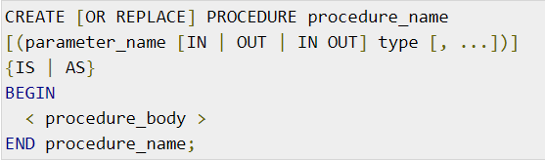
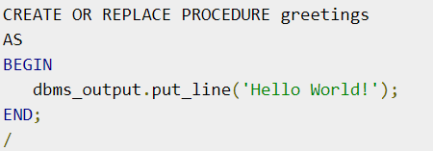
CREATING A PROCEDURE
PROCEDURE

Slide 4

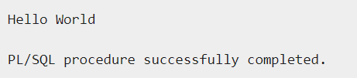
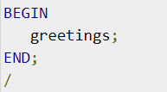
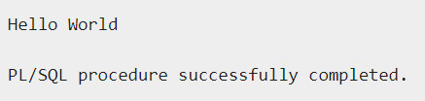
A standalone procedure can be called in two ways:
Using EXECUTE keyword
Calling the name of the procedure from PL/SQL block
EXECUTING A PROCEDURE

Slide 5


A standalone procedure is deleted with the DROP PROCEDURE
statement.
DELETING

Slide 6
You will have to define parameters to create a procedure.
There are three ways to pass a parameter in a procedure.
IN Parameter:
Used for giving input to the subprograms.
Read - only variable.
Value cannot be overwritten by the procedure.
By default, the parameters are of IN type.
OUT Parameter:
Used for getting output from the subprograms
Read - write variable.
Value can be overwritten by the procedure.
INOUT Parameter:
Used for both, giving input and getting output from subprograms.
Read - write variable.
Value can be overwritten by the procedure.
PARAMETERS

Slide 7
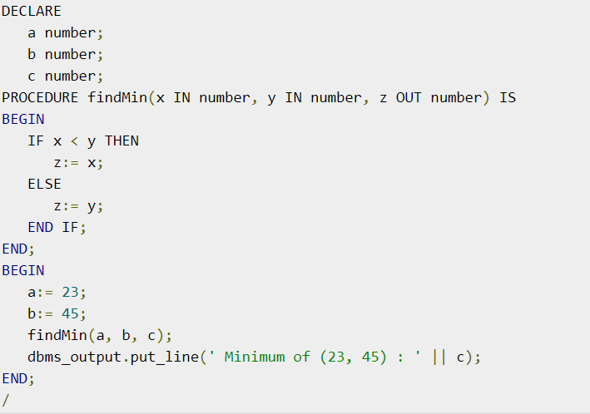
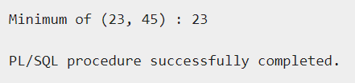
EXAMPLE 1

Slide 8
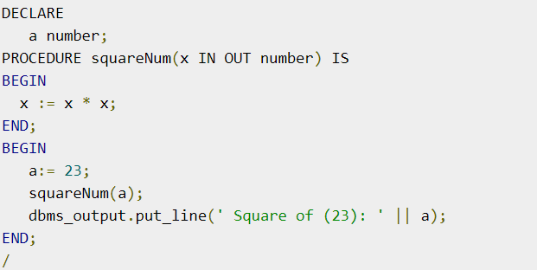
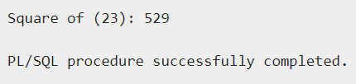
EXAMPLE 2

Slide 9
There are 3 methods:
Positional Notation:
The actual parameter is substituted for the formal parameter.
Named Notation:
The actual parameter is associated with the formal parameter using the arrow symbol ( => ) .
Mixed Notation:
We can mix both the notations in the procedure call. However, the positional should precede the name notation
Methods of
Passing Parameter

Slide 10




POSITIONAL NOTATION
NAMED NOTATION
MIXED NOTATION

Slide 11
CREATING A FUNCTION:
<syntax>
CREATING
FUNCTIONS

Slide 12
CREATING A FUNCTION:
<syntax>
CALLING A
FUNCTION

Slide 13
CREATING A FUNCTION:
<syntax>
RECURSIVE
FUNCTIONS

Slide 14
Syntax for creating and dropping.
Example program snipet

Slide 15
PROCEDURES vs FUNCTIONS

